Slide 1


Understanding SLR Parsers
Explore the fundamentals of SLR parsers, their core functionality, and practical applications in compiler design.
IFRA HABIB

Slide 2
What is an SLR Parser?
Definition
Key Characteristics
SLR (Simple LR) is a bottom-up parser in compiler design. It processes input left-to-right, building the parse tree from leaves to root. It uses a parsing table to shift tokens or reduce them to non-terminals.
Efficient for small to medium grammars, handling context-free grammars with LR(0) items and FOLLOW sets. It is simpler but less powerful than other LR parsers.

Slide 3





Bottom-Up Parsing Explained
Concept
Starts with input tokens, grouping them into larger structures using grammar rules. A stack tracks tokens and states, reducing sequences to non-terminals until the start symbol.
Shift
Push tokens onto the stack.
Reduce
Replace a sequence of tokens/non-terminals on the stack with a non-terminal using a grammar rule.
Accept
Parsing succeeds when the start symbol is derived.
Error
Occurs if an invalid token or state is encountered.

Slide 4

Use Cases of SLR Parser
Compiler Design
Parses programming languages like C and Java for syntactical correctness.
Syntax Checking
Ensures code adheres to grammar rules before further analysis.
Code Analysis Tools
Used in IDEs for syntax highlighting and error detection.
Domain-Specific Languages
Parses configuration files or custom languages with simple grammars.

Slide 5
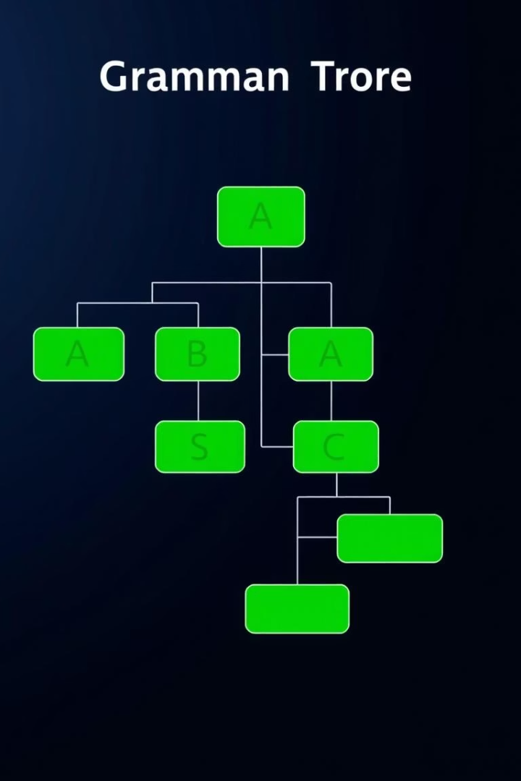
Sample Grammar for SLR Parser
S → P P → D P | S P | ε D → int id ; S → id = E ; E → E + T | E - T | T T → id | num | ( E ) | T * T | T / T
This grammar defines the structure of valid programs for the parser. Terminals include: int, id, ;, =, +, -, *, /, (, ), num, float.

Slide 6
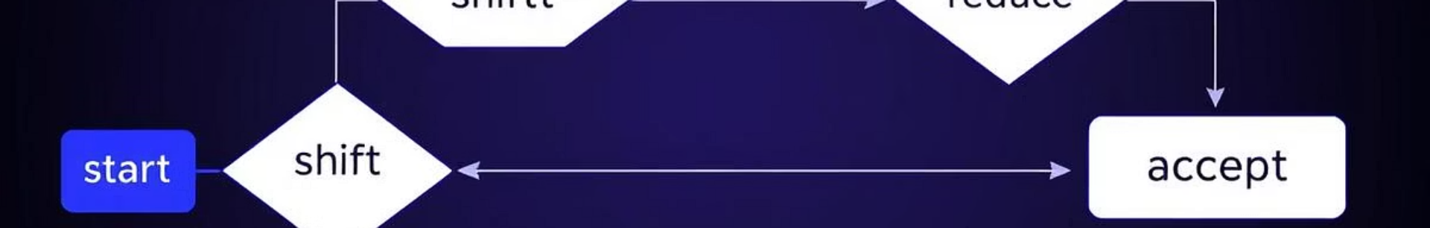



How SLR Parsing Works
Parsing Table
Contains ACTION (shift, reduce, accept) and GOTO (next state) entries.
Stack
Stores states and symbols during parsing.
Input
Sequence of tokens (e.g., int x ; x = 2 + 3 ;).
The process starts in state 0, reading input tokens. The ACTION table decides whether to shift, reduce, or accept. The GOTO table handles transitions after reductions.

Slide 7
Implementation Overview
InitializeFinalArray
PrintLexerOutput
Parse
Sets up the input token stream for the parser.
Tokenizes input and prints token types with positions.
Implements the SLR parsing algorithm using a stack and parsing table.
GetProduction
Semantic_Analysis
Defines grammar rules for reductions.
Checks type compatibility and evaluates expressions.

Slide 8




Implementation Challenges
Grammar Limitations
The current grammar does not support if statements or function declarations. Floats are tokenized but not fully handled semantically.
Error Handling
Reports syntax errors but lacks recovery. Semantic error detection is limited to basic operations.
Online Compiler Issues
Console output may require flushing. Some compilers may have runtime restrictions or lack System.Linq support.

Slide 9
SLR Parser: Benefits & Limitations
Benefits
Limitations
Efficient for simple grammars.
Cannot handle ambiguous or complex grammars.
Easier to implement than LALR or CLR.
Stops on the first syntax error (no recovery).
Guarantees correct parsing for unambiguous grammars.
Manual table construction is complex for large grammars.
Ideal for teaching compiler concepts.
Requires separate semantic analysis.
Suitable for small languages or scripts.

